Slide 1
Patient disease and mortality prediction using EMRs
Presented by : -
Rudra Kosambi – (20BCP074)
Kenil Ghetia – (20BCP0139)

Slide 2
Abstract
The use of electronic medical reports (EMRs) for disease and mortality prediction has numerous benefits and is increasingly recognized as an important tool in healthcare.
It has numerous benefits, including early detection, improved outcomes, cost-effectiveness, personalized care, and contributions to public health.
Additionally, disease and mortality prediction with the help of EMRs is needed to prioritize patients and mortality, allowing healthcare providers to allocate resources more efficiently and effectively.

Slide 3
Introduction
The use of electronic medical reports (EMRs) for disease and mortality prediction has numerous benefits and is increasingly recognized as an important tool in healthcare.
EMRs can provide insights into patient health histories, allowing doctors to identify patterns and trends that may indicate a potential health issue before symptoms appear.
By identifying health issues early, doctors can initiate treatment sooner, potentially preventing the progression of a disease or condition.
For this project, we have proposed different machine learning techniques such as Random Forest Classifier and Support vector machine.
To check model performance we calculate accuracy, precision, recall and brier score.

Slide 4
Dataset
This dataset has been taken from MIT’s GOSSIS (Global Open Source Illness Score) initiative.
It consists of 91714 instances and 85 columns.
Some of the key features of this dataset are:
ICU admit source: Source of injury for hospitalization.
ICU type: The type of ICU patient is in.
Ventilated: The patient is ventilated or not.
Glucose: Minimum and maximum glucose level of patient.
Potassium: Minimum and maximum potassium level of patient.

Slide 5
Literature Review
Dhiraj Dahiwade et. al.(2019) applied KNN and CNN algorithms and found that CNN is better algorithm in terms of accuracy and time.
S.Leoni Sharmila et. al.(2017) applied multiple algorithms for disease classification and found Fuzzy neural networks to be most effective with accuracy of 91%.
Kohli P.S. et al.(2018) applied multiple ML models on breast cancer, diabetes and heart disease datasets and found Logistic Regression to be most effective and got accuracy of 95%, 77% and 80% respectively for disease prediction.
Quirina C.B.S. Thio et. al.(2020) implemented five machine learning models for survival prediction and concluded Random Forest to most effective closely followed by support vector machine.
Shinya Iwase et. al.(2022) implemented multiple ML models to predict ICU Mortality and found Random Forest to be most precise with accuracy, specificity and brier score of 94.5%, 87.5% and 0.028 respectively.
Jian Hu et. al.(2021) used radial basis function artificial neural network model and achieved sensitivity, specificity and accuracy as 83.6%, 88.5% and 82.5%, respectively for mortality prediction.

Slide 6
Methodology
Pre-processing of the data was done which included replacing null values and removing outliers. Correlated and constant features were dropped.
Label encoding was done for required features.
The data was then divided into training and testing sets.
The train set was then used to train machine learning models like Recurrent Neural Network (RNN), Random Forest Classifier, Support vector machine and Logistic Regression.
The results were then compared by calculating accuracy, precision, recall and brier score.

Slide 7
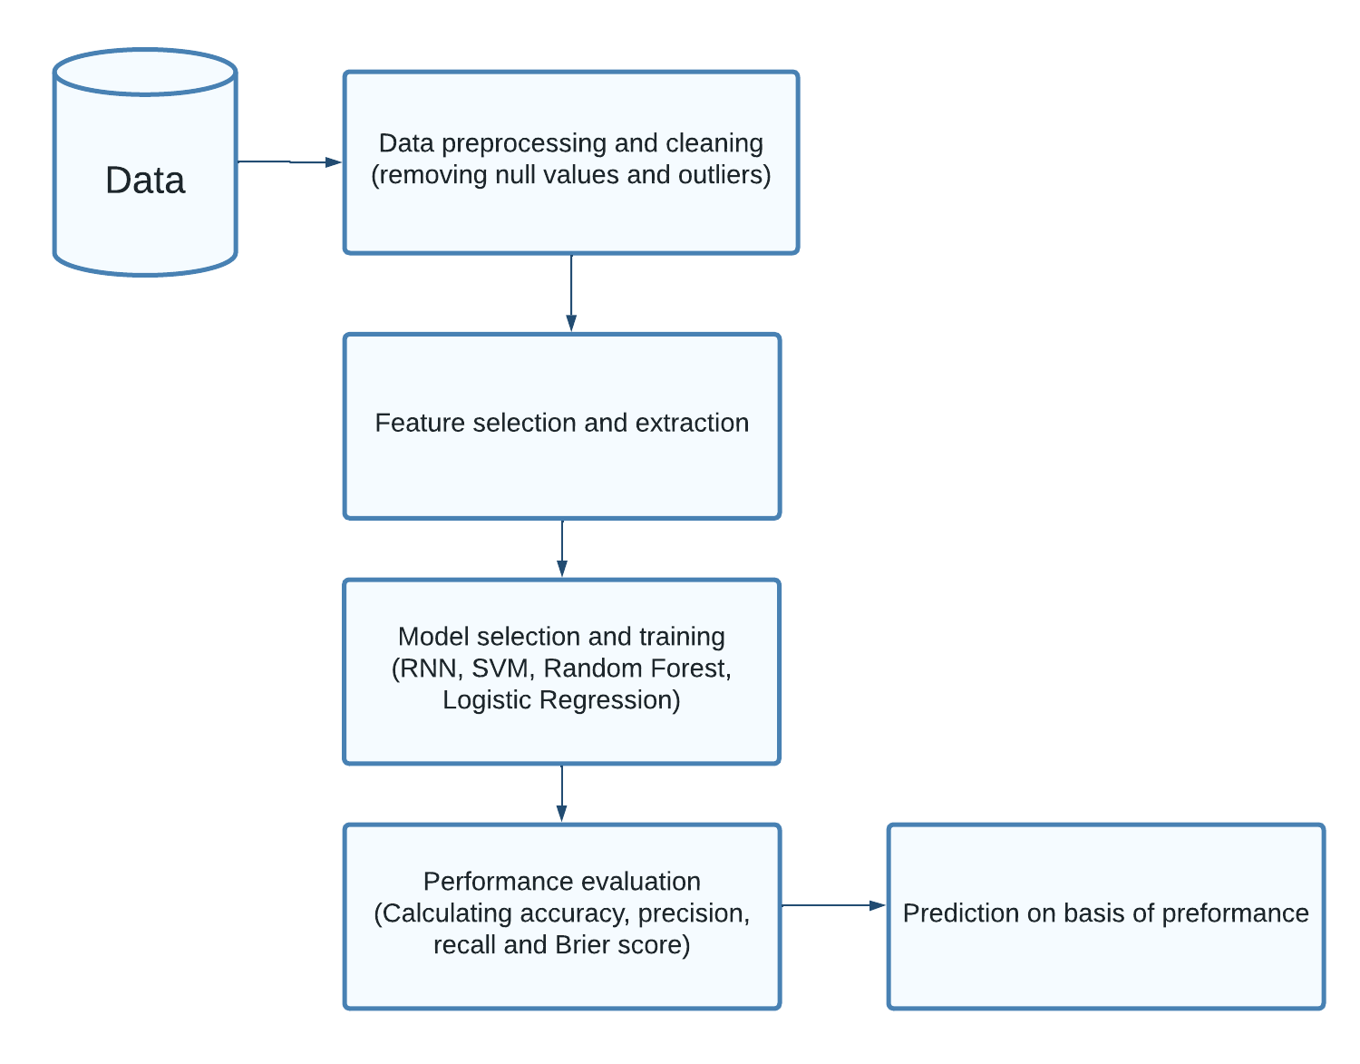
Architecture diagram

Slide 8
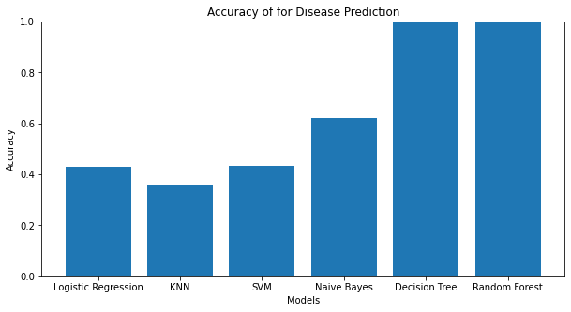
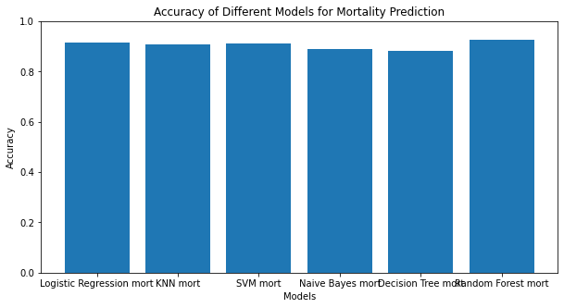
Result
Decision tree classifier and random forest classifier turned out to be most effective for disease prediction among all six machine learning models with accuracy of about 99% accuracy.
K-Nearest Neighbours and Support vector machine were the worst performers with accuracy of 36% and 43% respectively.
In case of mortality prediction using EMRs almost all the machine learning models performed equally with Random Forest classifier performing the best with accuracy of 92.6%.

Slide 9
References
Dhiraj Dahiwade, Prof. Gajanan Patle, Prof. Ektaa Meshram(2019). Designing Disease Prediction Model Using Machine Learning Approach in IEEE.
S.Leoni Sharmila, C.Dharuman and P.Venkatesan(2017). Disease Classification Using Machine Learning Algorithms - A Comparative Study in Internatioinal Journal of Pure and Applied Mathematics.
Kohli P.S. , Shriya Arora(2018). Application of Machine Learning in Disease Prediction in IEEE.
Quirina C. B. S. Thio, corresponding author Aditya V. Karhade, Bas Bindels, Paul T. Ogink, Jos A. M. Bramer, Marco L. Ferrone, Santiago Lozano Calderón, Kevin A. Raskin, and Joseph H. Schwab(2020). Development and Internal Validation of Machine Learning Algorithms for Preoperative Survival Prediction of Extremity Metastatic Disease in Clinical Orthopaedics and Related Research.
Shinya Iwase, Taka-aki Nakada, Tadanaga Shimada, Takehiko Oami, Takashi Shimazui, Nozomi Takahashi, Jun Yamabe, Yasuo Yamao & Eiryo Kawakami(2022). Prediction algorithm for ICU mortality and length of stay using machine learning in Scientific reports of Nature journal.
Jian Hu YangFei, Wei‑qin Li(2021). Predicting the mortality risk of acute respiratory distress syndrome: radial basis function artificial neural network model versus logistic regression model in Journal of Clinical Monitoring and Computing.

Slide 10
THANK YOU

